Slide 1
Module 1:
Introduction to Azure Concepts and Core Azure Services

Slide 2
Module 1: Lesson 5
Azure networking services fundamentals

Slide 3



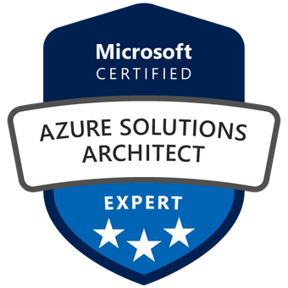
About The Presenter
Mohammed Adel
Senior Cloud Engineer / MAF Retail (Carrefour) / 15 years in the field
Microsoft Certified Azure Solution Architect
IT Operations and infrastructure background.
Hold other various certificates, MCP/MCSA/MCITP/CFDE

Slide 4
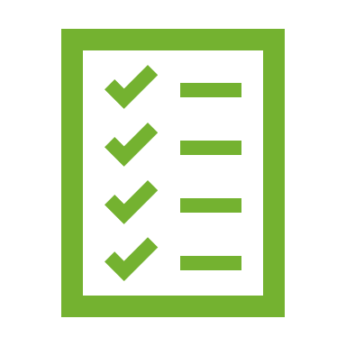

Lesson 5: Overview
This lesson will cover
Azure Virtual networks fundamentals
Azure VPN Gateway fundamentals
Azure ExpressRoute fundamentals

Slide 5
Module 1: Lesson 5
What is Azure virtual networking?
Why we need Azure virtual networks?
Demo: Creating Azure virtual network
What is Azure VPN Gateway?
What is Azure ExpressRoute?

Slide 6
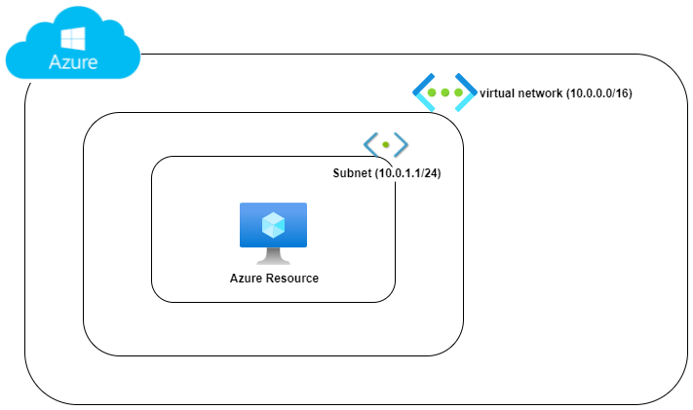
What is Azure virtual networking?
“Azure virtual networks enable Azure resources, such as VMs, web apps, and databases, to communicate with each other, with users on the internet, and with your on-premises client computers” - Microsoft.com
VNET: Virtual network.
Subnet: a segment of the virtual network.
CIDR address (10.0.0.0/16)
DNS: Domain name System, used for name resolution.
DHCP: Dynamic Host Configuration Protocol, used to assign dynamic IPs.
Gateway: used to connect two different networks.
Notes:
https://docs.microsoft.com/en-us/learn/modules/azure-networking-fundamentals/azure-virtual-network-fundamentals
Be familiar with basic networking terms such as IP/Gateway/DNS/Subents/CIDR addresses.
CIDR (Classless Inter-Domain Routing), method for allocating IP addresses and for IP routing

Slide 7
Why we need Azure virtual networks?
Isolation and segmentation
Isolate your hosted workloads and multi-tier applications (frontend/backend).
Internet communications
Available by defaults to connected VMs.
Communicate between Azure resources
Service points such as (Azure SQL, storage accounts).
Other virtual networks.
Communicate with on-premises resources
Point-to-Site / Site-to-Site / ExpressRoute
Route network traffic
Route Table / Boarder Gateway Protocol (BGP)
Filter network traffic
Network Security Group (NSG) / Network Virtual Appliance (NVA)
Connect virtual networks
Peering
Notes:
https://docs.microsoft.com/en-us/learn/modules/azure-networking-fundamentals/azure-virtual-network-fundamentals
Useful tools
https://www.davidc.net/sites/default/subnets/subnets.html
Other Notes:
Border Gateway Protocol (BGP) works with Azure VPN gateways or ExpressRoute to propagate on-premises BGP routes to Azure virtual networks.
Peering enables resources in each virtual network to communicate with each other.

Slide 8
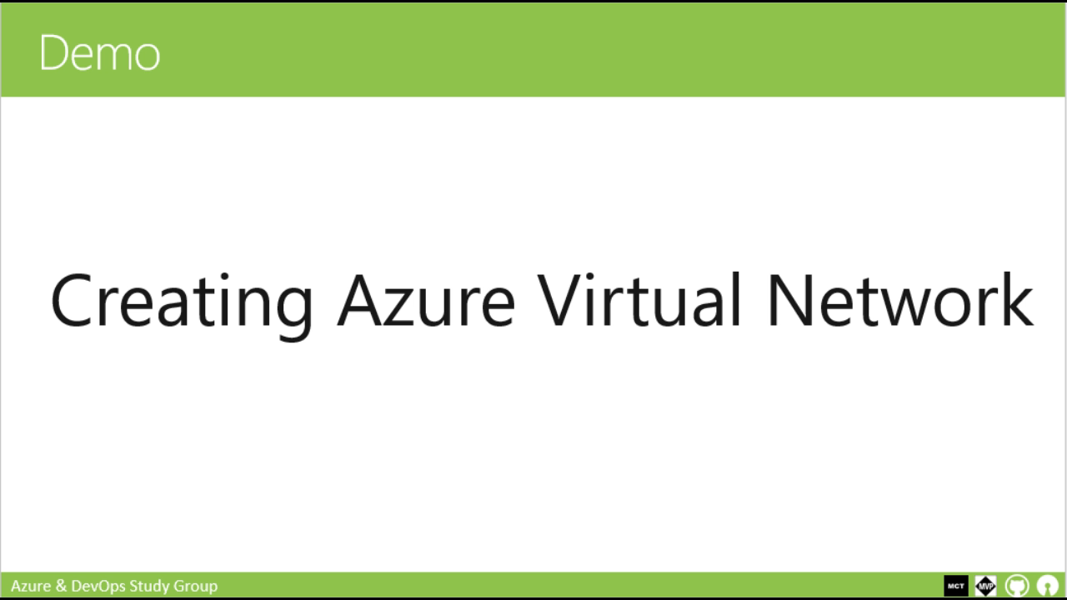
Demo
Creating Azure Virtual Network
Notes:
https://docs.microsoft.com/en-us/learn/modules/azure-networking-fundamentals/azure-virtual-network-fundamentals

Slide 9
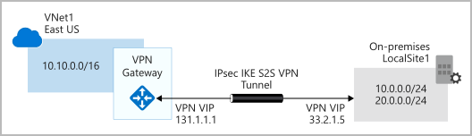
What is Azure VPN Gateway?
VPN: Virtual Private Network.
An encrypted tunnel between two or more trusted networks over untrusted network (internet).
Azure VPN Gateway is a type of virtual network gateway deployed in virtual network to enable the following:
Connect on-premises datacenters to virtual networks through a site-to-site connection.
Connect individual devices to virtual networks through a point-to-site connection.
Connect virtual networks to other virtual networks through a network-to-network connection
*Image source Microsoft.com
Notes:
https://docs.microsoft.com/en-us/learn/modules/azure-networking-fundamentals/azure-vpn-gateway-fundamentals

Slide 10
What is Azure VPN Gateway?
Only one VPN Gateway can exist in a VNET, but it can be used to connect multiple locations (other VNETs / On-premises).
VPN type: either policy-based or route-based
Both types rely on Internet Key Exchange (IKE) and Internet Protocol Security (IPSec) and use a pre-shared key to authenticate.
IKE is used to set up a security association (an agreement of the encryption) between two endpoints. This association is then passed to the IPSec suite, which encrypts and decrypts data packets encapsulated in the VPN tunnel.
Policy-based: specify statically the IP address of packets that should be encrypted through each tunnel.
Route-based: IPSec tunnels are modeled as a network interface or virtual tunnel interface.
Notes:
https://docs.microsoft.com/en-us/learn/modules/azure-networking-fundamentals/azure-vpn-gateway-fundamentals
VPN Types details: https://docs.microsoft.com/en-us/azure/vpn-gateway/vpn-gateway-connect-multiple-policybased-rm-ps

Slide 11
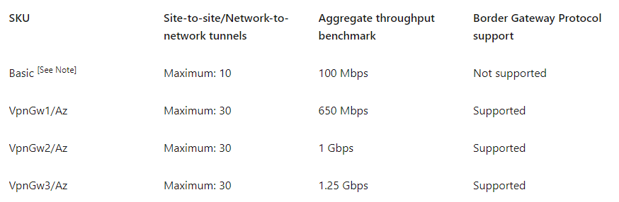
What is Azure VPN Gateway?
VPN Gateways comes in different sizes and capabilities
*Image source Microsoft.com
Notes:
https://docs.microsoft.com/en-us/learn/modules/azure-networking-fundamentals/azure-vpn-gateway-fundamentals

Slide 12
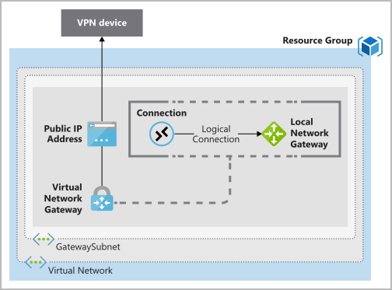
What is Azure VPN Gateway?
To deploy a VPN Gateway, you will need the following resources
On Azure
Virtual Network
GatewaySubnet
Public IP Address
Local Network Gateway
Virtual Network Gateway
Connection
On-Premises
A VPN device that support both VPN Types.
A Public-facing IP address (IPv4).
*Image source Microsoft.com
Notes:
https://docs.microsoft.com/en-us/learn/modules/azure-networking-fundamentals/azure-vpn-gateway-fundamentals
Local network gateway. Create a local network gateway to define the on-premises network's configuration, such as where the VPN gateway will connect and what it will connect to. This configuration includes the on-premises VPN device's public IPv4 address and the on-premises routable networks. This information is used by the VPN gateway to route packets that are destined for on-premises networks through the IPSec tunnel.

Slide 13
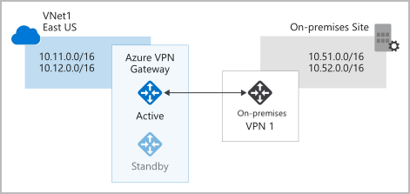
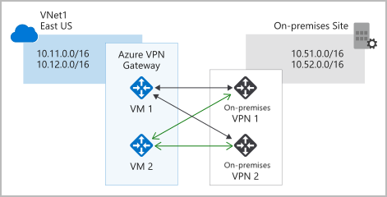
What is Azure VPN Gateway?
High Availability (HA) supported scenarios
Active / Standby
Active / Active
ExpressRoute failover
Zone-redundant gateways
*Image source Microsoft.com
Notes:
https://docs.microsoft.com/en-us/learn/modules/azure-networking-fundamentals/azure-vpn-gateway-fundamentals

Slide 14
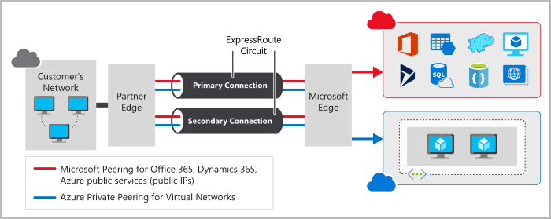
What is Azure ExpressRoute?
“ExpressRoute lets you extend your on-premises networks into the Microsoft cloud over a private connection with the help of a connectivity provider.” – Microsoft.com
*Image source Microsoft.com
Notes:
https://docs.microsoft.com/en-us/learn/modules/azure-networking-fundamentals/express-route-fundamentals

Slide 15
What is Azure ExpressRoute?
Why we need ExpressRoute
Layer 3 connectivity between your on-premises network and the Microsoft Cloud through a connectivity provider across all regions.
Dynamic routing between your network and Microsoft via BGP.
Built-in redundancy in every peering location for higher reliability.
Connection uptime SLA.
Notes:
https://docs.microsoft.com/en-us/learn/modules/azure-networking-fundamentals/express-route-fundamentals

Slide 16



Prepare for The Exam (Q/A)
How can you connect two separate Azure VNETs?
Domain Naming Systems
ExpressRoute
VNET Peering
ExpressRoute is used to ……
Provide a redundant Connectivity between On-Premises and Microsoft Cloud Services
Connecting on-premises networks to Azure different regions.
All of the Above

Slide 17
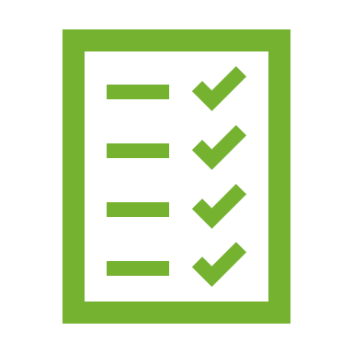
Summary
This lesson has covered
Azure Kubernetes Service (AKS)
Azure Kubernetes Service (AKS) Commands
Demo: Creating and Exploring Azure Kubernetes Service
Demo: Deploying Azure Kubernetes Service from Azure DevOps
Prepare for The Exam (Q/A)
Next Lesson:
(1) Introduction and Module Overview for Module 3
Notes:
How Cloud Can Help DevOps Transformation

